Slide 1

SRM INSTITUTE OF SCIENCE AND TECHNOLOGY
RAMAPURAM
DEPARTMENT OF COMPUTER SCIENCE AND ENGINEERING
21GNP301L- COMMUNITY CONNECT
Student Details
Name: SREEJITH P A,
Reg No.: RA2411003020328
Class & Dept : B.Tech CSE F
Course Incharge Details
Dr. Saraswati
Assistant Professor
B.Tech CSE

Slide 2
Presentation overview:
Course Overview
About the Organization
Objective of choosing the specific ngo
Nature of Activities of the ngo
Week-wise activity undertaken
Tangible learning
Student contribution to ngo during the service period:certificate

Slide 3
Course overview
Need of the Course: Community Connect is designed to in still social responsibility and civic engagement in engineering students by involving them directly in community/environmental service. It bridges classroom learning with real-world impact.
Organization Details: Green Voice Global — an environmental NGO focused on afforestation, ecological restoration, and sustainability awareness among youth and local communities.
Duration of Course: 8 weeks (mention your actual start–end dates), conducted as part of the 21GNP301L curriculum.

Slide 4
ABOUT THE ORGANIZATION:
Overview:
❖ Green Voice Global (NGO) is a registered trust based in Velachery, Chennai, working to raise public awareness about the environment, health, and education since its formation in 2001.
❖ Founded by Mr. C.S. Veerraghavan, its Founder and Chairman.
❖ It has grown from a small local initiative into a multi-vertical organization impacting communities across Chennai and surrounding regions.
❖ The NGO's work spans four verticals: Environment, Education, Sustainable Development, and Health.

Slide 5

ABOUT THE ORGANIZATION:
Founder’s Story:
❖ Mr. Veerraghavan built the organization despite living with visual impairment, driven by a personal passion for creating positive social change.
❖ His journey reflects that determination and vision matter more than circumstance — a message he actively carries into the NGO's youth outreach programs.
❖ Under his leadership, Green Voice Global has expanded its reach from single awareness drives to structured, recurring community programs.
❖ He continues to personally engage with volunteers and student groups during major drives.

Slide 6
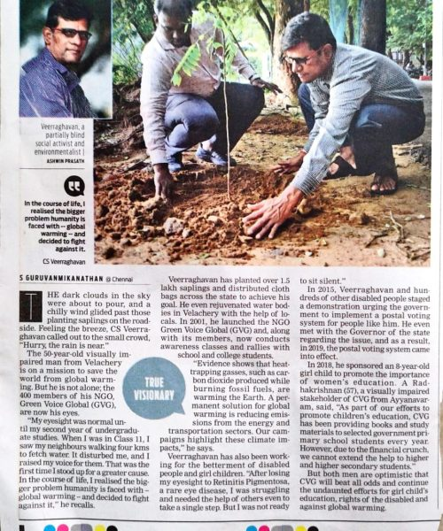
ABOUT THE ORGANIZATION:
Organizational Structure:
❖ The NGO operates through a core team of coordinators supported by a wider volunteer network drawn from colleges, residents' associations, and youth groups.
❖ Field activities (plantation drives, camps, awareness sessions) are organized zone-wise across Chennai.
❖ Partnerships with schools, colleges, and local community groups help the NGO extend its reach for both awareness and hands-on activities.
❖ Volunteers like students on Community Connect are integrated directly into ongoing field operations rather than kept to observer roles.

Slide 7
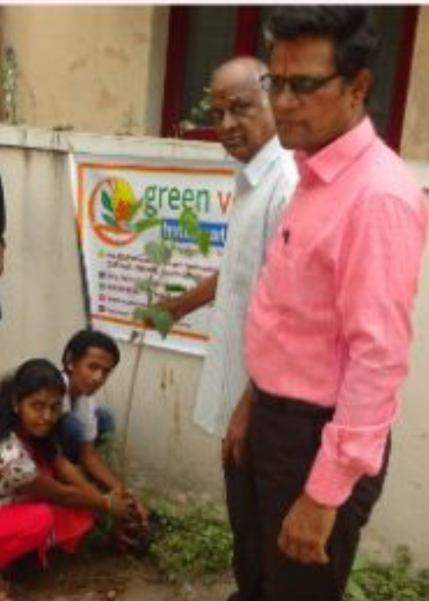
ABOUT THE ORGANIZATION:
Core Focus Areas:
❖ Environment: tree planting, sapling distribution, awareness campaigns, rainwater harvesting rallies
❖ Education: free tuition, scholarships, school-supply drives, exam-fear training
❖ Sustainable Development: youth training, employment fairs, capacity building
❖ Health: medical camps, child health and hygiene awareness
❖ This project engaged specifically with the Environment vertical.

Slide 8
Objective of choosing the specific ngo
Why This NGO?
❖ Green Voice Global was chosen because its environment vertical offers direct, hands-on participation in tree plantation and awareness work, rather than purely donation-based involvement.
❖ Its structured, recurring field activities (rather than one-off events) made it possible to track progress and contribution across the full 8-week service period.
❖ The NGO's presence within Chennai made regular, in-person participation logistically practical for a student volunteer.

Slide 9
Objective of choosing the specific ngo
Personal and Academic Objectives:
❖ To apply classroom knowledge of sustainability and environmental science to real ground-level action.
❖ To understand how a grassroots NGO plans, organizes, and executes public awareness campaigns.
❖ To develop communication and outreach skills by directly engaging with school students and residents.
❖ To fulfil the Community Connect course's goal of building civic responsibility through real community engagement.

Slide 10
Objective of choosing the specific ngo
Broader Motivation:
❖ Inspired by founder Mr. C.S. Veerraghavan's story of building an impact-driven organization despite personal challenges.
❖ Wanted to be part of an initiative addressing climate change and deforestation at a local, actionable level rather than only at a policy level.
❖ Aimed to build a long-term habit of environmental responsibility that continues beyond the course requirement.

Slide 11
Nature of ACTIVITies of the ngo
Overview of the Four Verticals:
❖ Green Voice Global runs initiatives across four core verticals: Environment, Education, Sustainable Development, and Health.
❖ Each vertical combines awareness-building with direct, on-ground action rather than fundraising alone.
❖ This structure allows the NGO to address interconnected community needs, not just isolated causes.

Slide 12
Nature of Activities of the ngo
Environment Vertical (Primary Focus):
❖ Tree planting drives in both rural and urban areas using locally-suited native species.
❖ Sapling distribution to the public, along with aftercare guidance.
❖ Awareness campaigns in schools and colleges on deforestation and climate change.
❖ Public rallies promoting rainwater harvesting and action on global warming.

Slide 13
Nature of Activities of the ngo
Other Verticals (Education, Sustainable Development, Health):
❖ Education: Free tuition, scholarships for marginalized students, school-supply distribution drives, exam-fear training programs.
❖ Sustainable Development: Youth Development Training, capacity-building programs, employment fairs for the unemployed in slum areas.
❖ Health: Medical camps, child health and hygiene awareness, advice sessions for mothers supported by doctors.
❖ While broader in scope, these verticals reflect the NGO's holistic community-development approach.

Slide 14
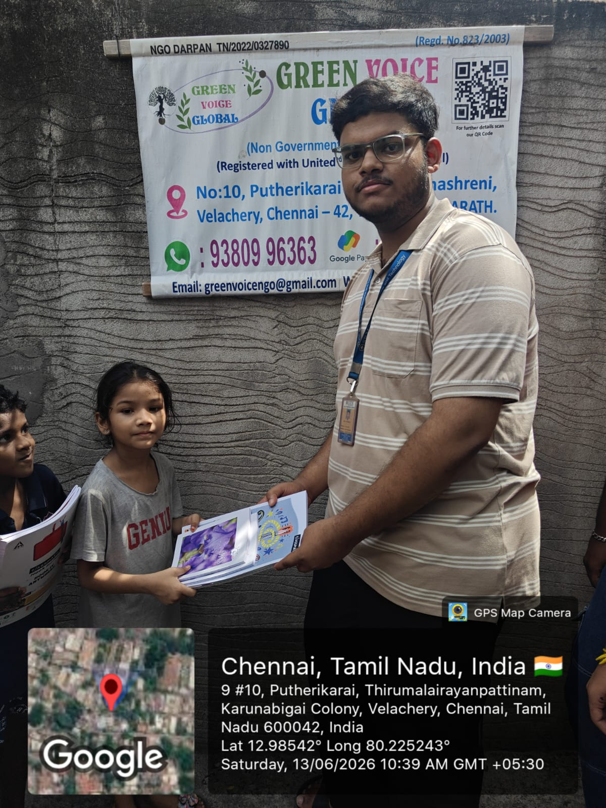
Week-wise activity undertaken
Distributed environmental awareness booklets to local children in Velachery as part of Green Voice Global’s community outreach program, encouraging early awareness of tree conservation.

Slide 15
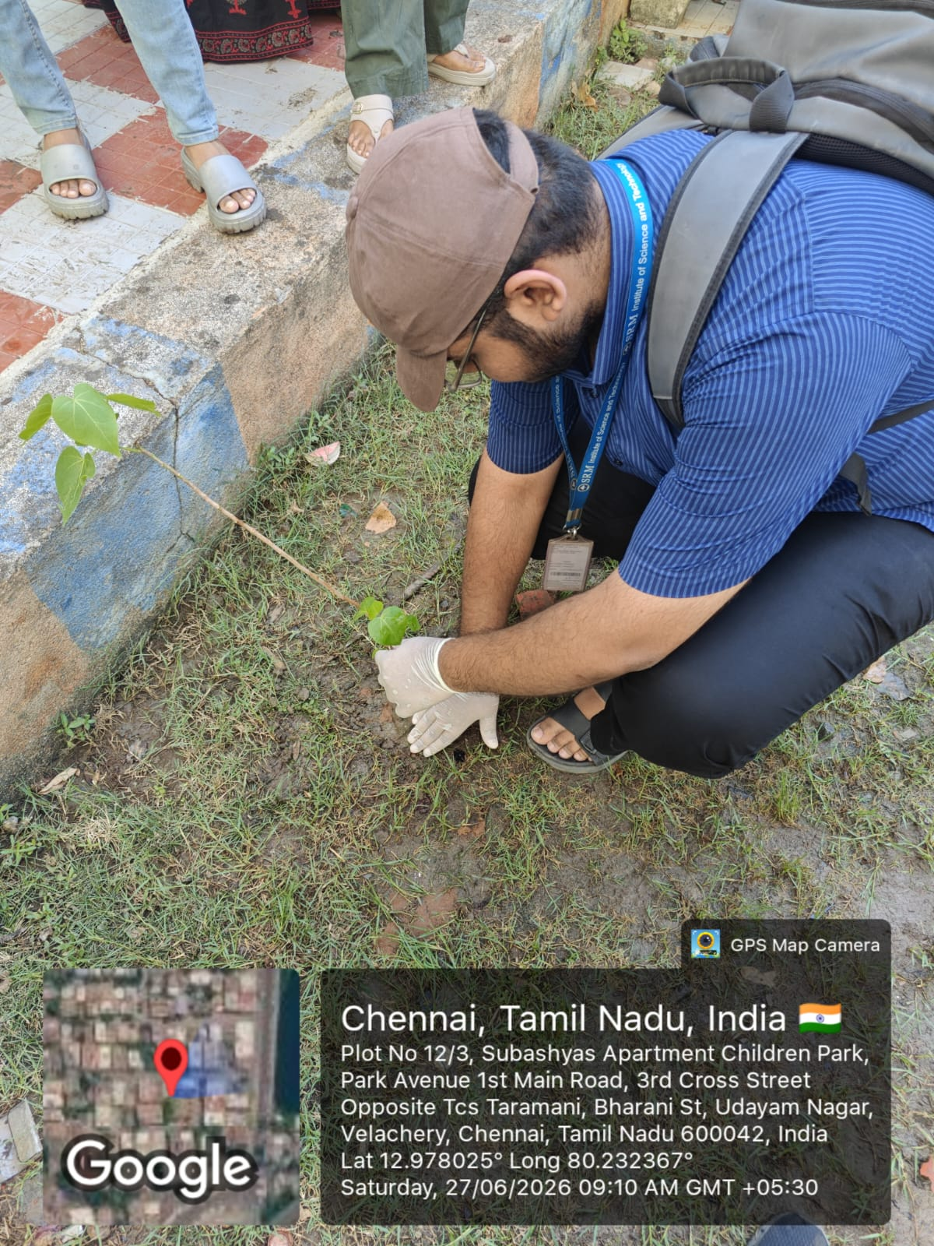
Week-wise activity undertaken
Participated in a sapling plantation drive at Children's Park, Velachery — carefully planted and secured a young tree along the park boundary.

Slide 16
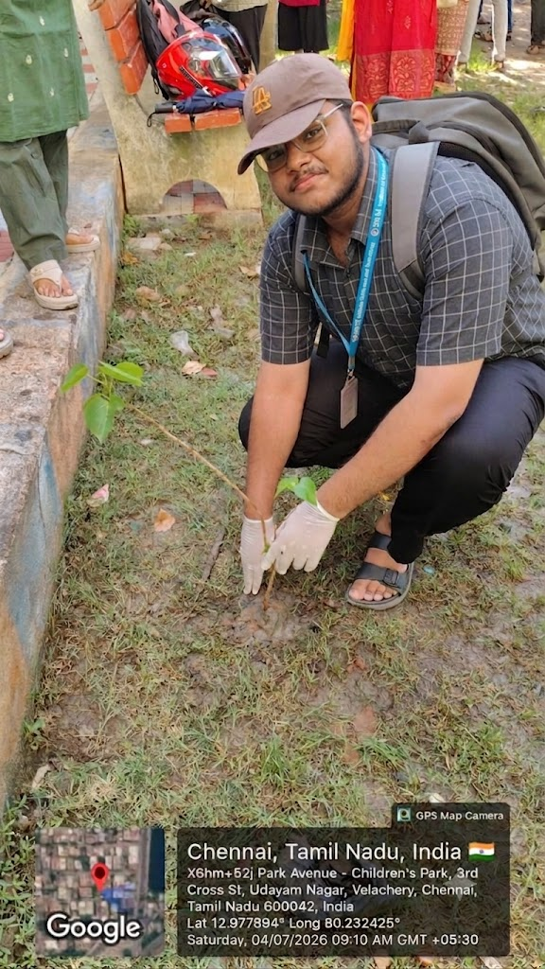
Week-wise activity undertaken
Came back a week later to check on the sapling's growth and make sure it was well-nourished.

Slide 17
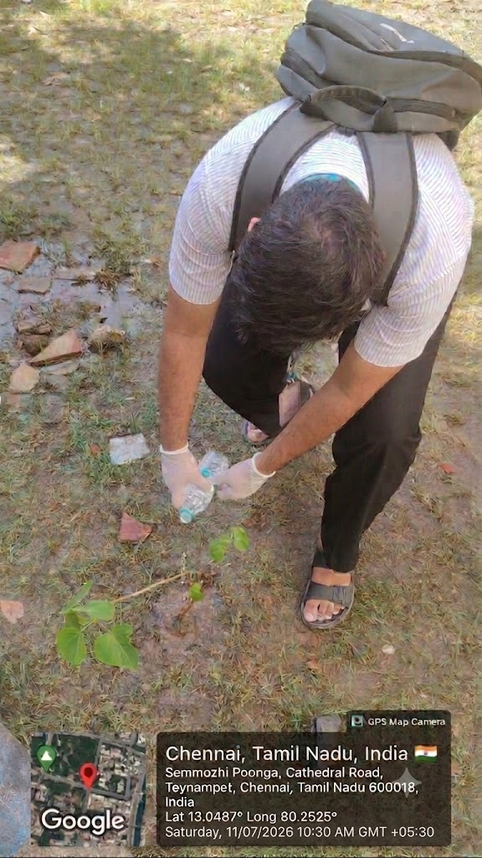
Week-wise activity undertaken
Planted more saplings on a weekly basis

Slide 18
Tangible learning
Technical/Practical Learning:
❖ Gained practical knowledge of tree plantation techniques — pit preparation, spacing, soil treatment, and species selection suited to local conditions.
❖ Understood real ground-level environmental challenges (poor soil quality, water scarcity, urban heat) not always evident from textbook study.
❖ Learned to assess sapling survival and basic aftercare requirements.

Slide 19
Tangible learning
Interpersonal & Soft Skills:
❖ Improved public communication skills through direct interaction with school students and residents during awareness sessions.
❖ Developed teamwork and coordination skills working alongside NGO volunteers and community members from diverse backgrounds.
❖ Built confidence in organizing and leading small group activities in the field.

Slide 20
Tangible learning
Personal & Civic Growth:
❖ Developed a lasting sense of environmental and civic responsibility that extends beyond the course requirement.
❖ Gained perspective on how grassroots-level action complements larger environmental policy efforts.
❖ Inspired to continue independent volunteering with environmental causes going forward.

Slide 21
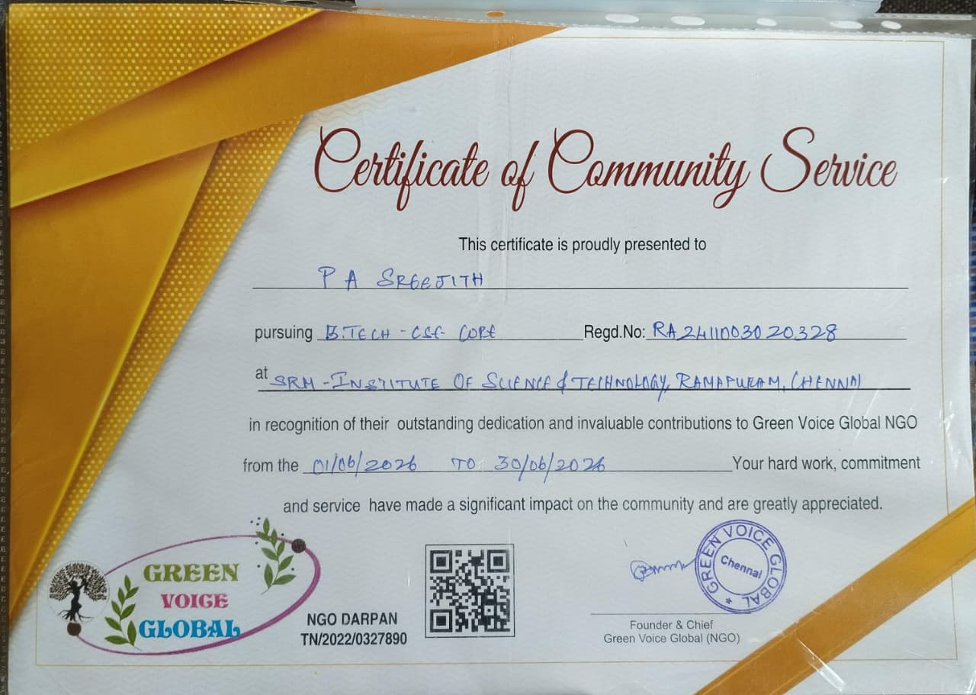
certificate

Slide 22
THANK YOU

